Slide 1
Quantum Standard version Installation Guide
HQ Investment & Consulting Corporation

Slide 2
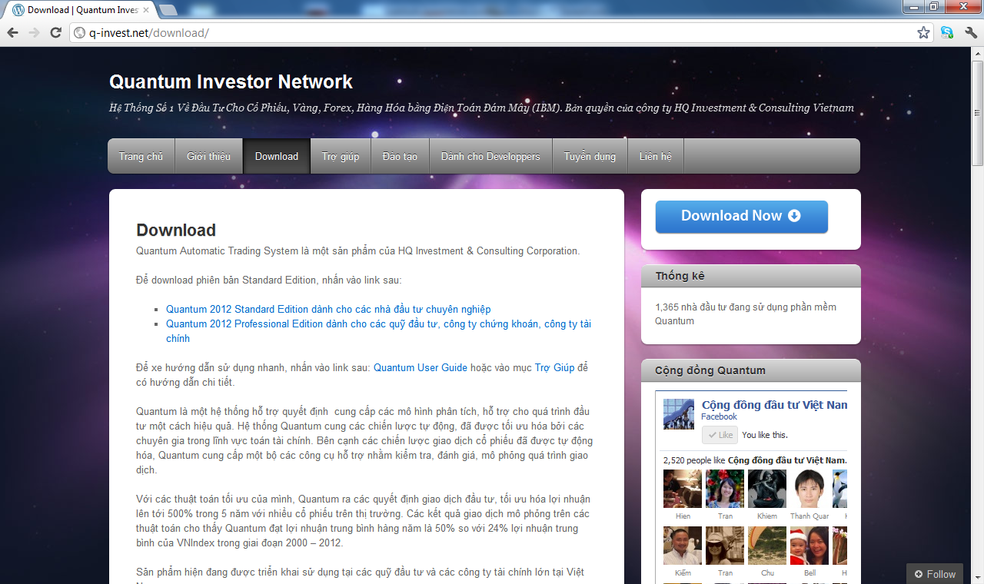
Download Page: www.q-invest.net

Slide 3
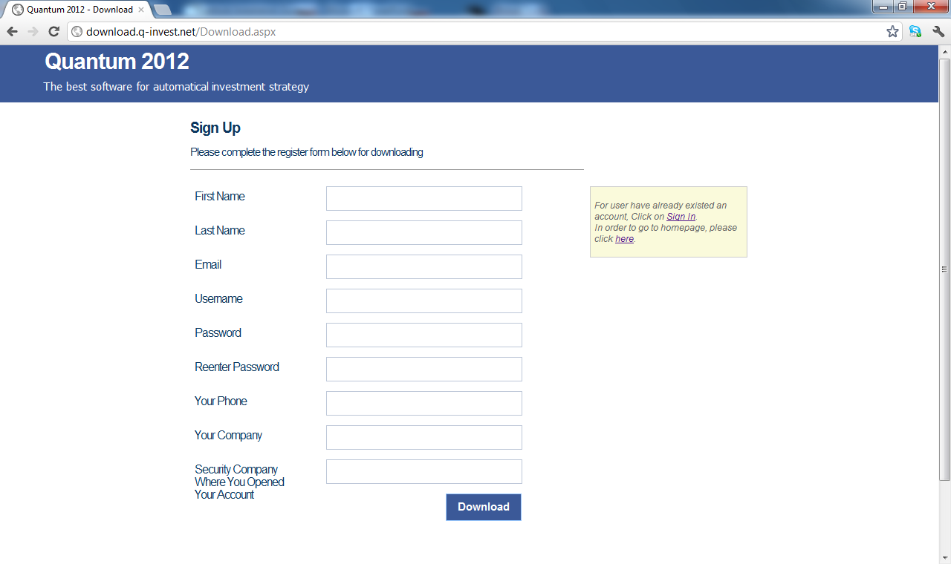
Enter your information

Slide 4
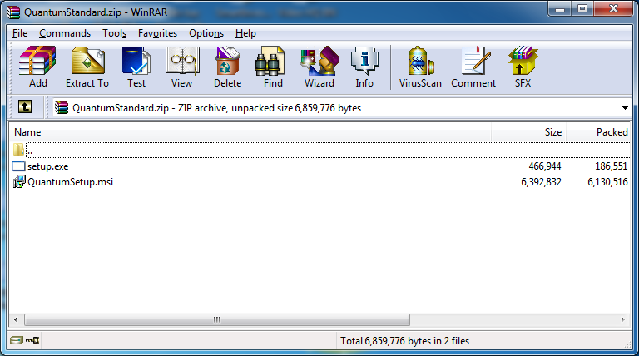
Step 1: unzip and run setup.exe

Slide 5
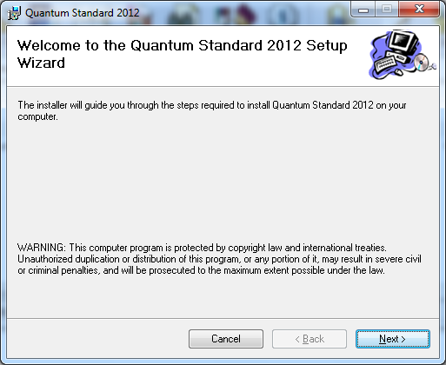
Step 2: click Next

Slide 6
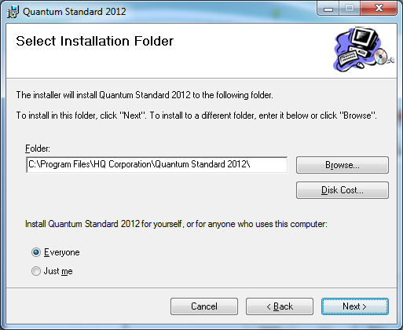
Step 3: Choose Folder & click Next

Slide 7
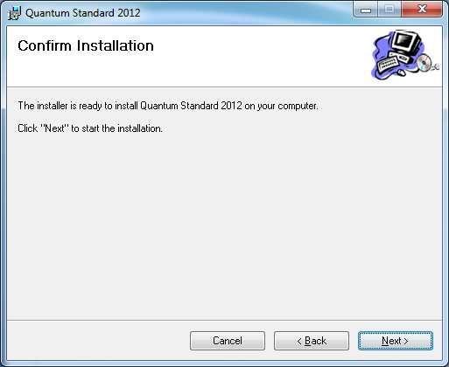
Step 4: Confirm Installation

Slide 8
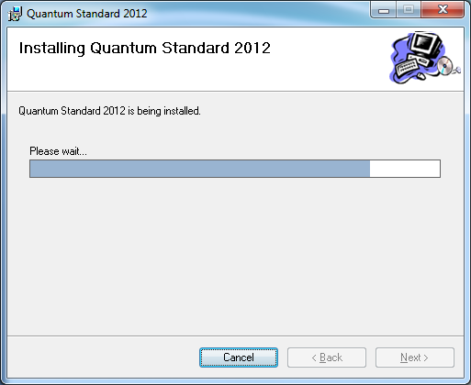
Step 5: Wait for installation

Slide 9
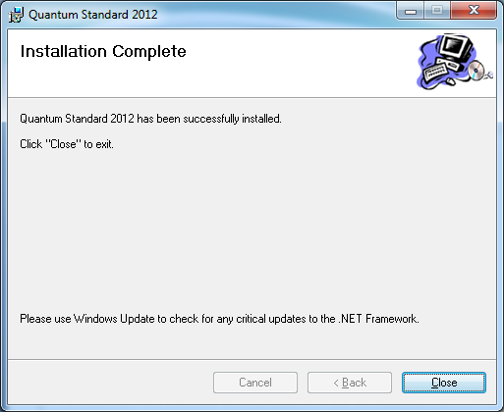
Step 6: Close and Finish Installation

Slide 10

Step 7: Run Quantum

Slide 11
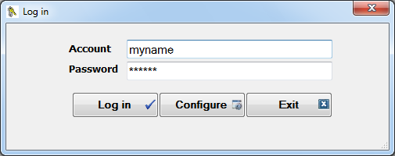
Step 8: Login

Slide 12
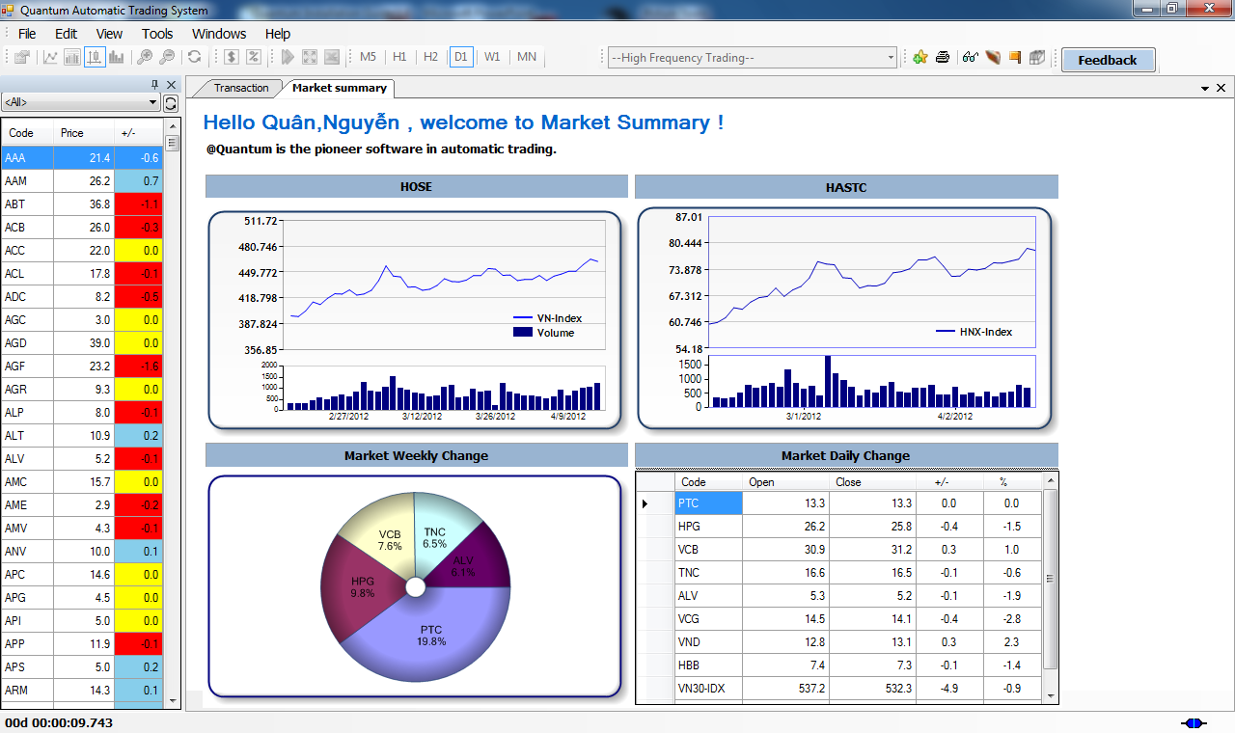
Step 9: Main page

